Slide 1
Mr. Cat GPTA
Greyson Henry
Dr. Sultan

Slide 2
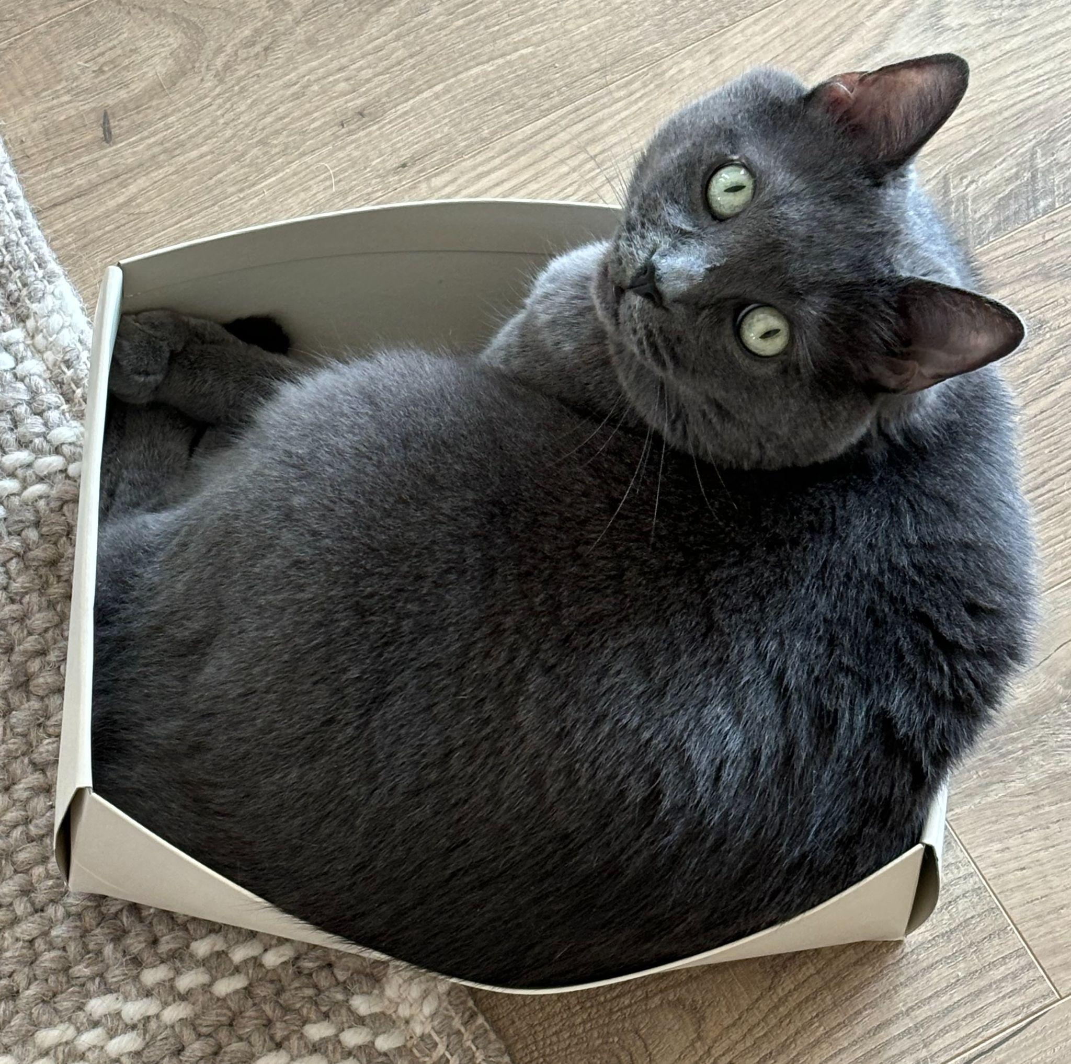
What is Mr. Cat GPTA?
Mr. Cat GPTA is a continuation of a research project from last summer.
Beta release as TA for CSC-272 last Fall
This summer
Incorporating lessons learned and feedback
Expanded the scope to general-purpose learning software.

Slide 3
Motivation - why this, and why now?
THEORETICAL | PRACTICAL
Chatbots open up radical opportunities for personalized education (Labadze, et al.) Extreme flexibility of chatbots and NNs at large (Schäfer, et al.) make them good at handling many learning styles | Higher-performance, lower-cost LLMs available to the public “Generative AI” is exploding in popularity, it’s good practice to interface with them as a user and a dev Existing bot infrastructure from last year (Jack Patterson and Emirhan Gencer) More Furman CS projects!
Notes:
The dream: Individualized/Tailor-made/Bespoke Learning Pathway
But resource and time intensive
Chatbots are taking over the world
Unprecedented opportunity to realize this dream of individual attention..
<Cite some survey that talks about its usage/popularity for learning>
State of the art only scratches the surface
Mr. Cat GPTA is a continuation of the TA bot research done last year by Jack Patterson and Emirhan Gencer.

Slide 4
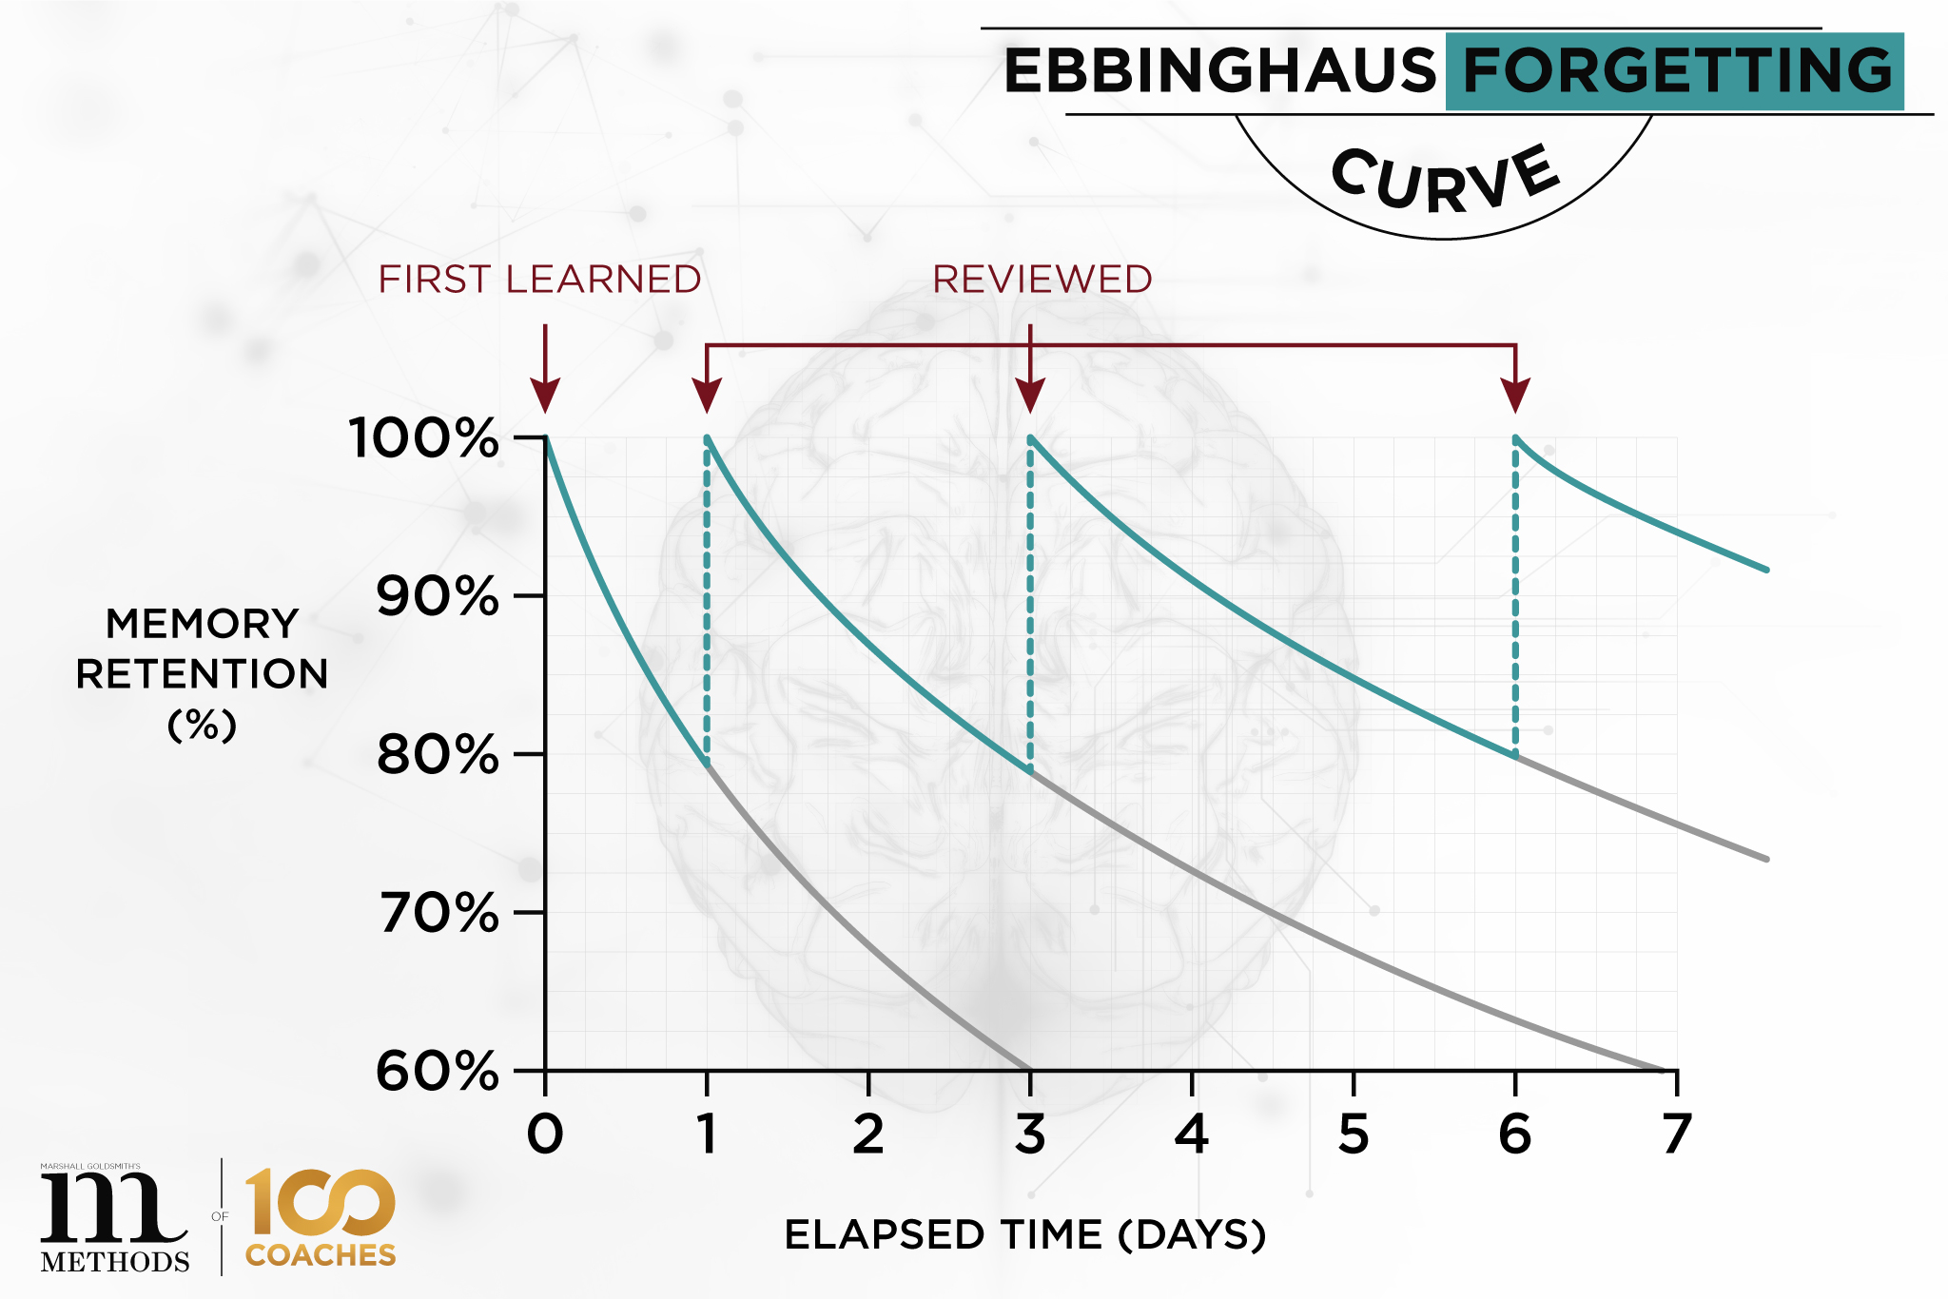
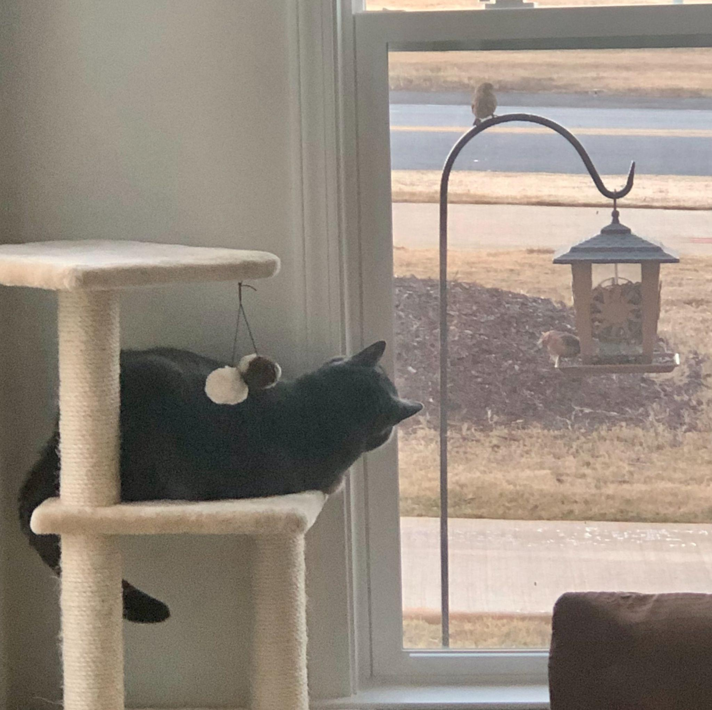
“The Dream”
“The Reality”
The end goal was/is to have a tool to make a bespoke, iterative, and widely usable learning pathway for users.
Image: https://methodsof.com/blog/the-ebbinghaus-forgetting-curve/
This isn’t a one-summer project. “Comprehensive” learning needs a lot of lower-level tools, so I worked on getting those set up.

Slide 5
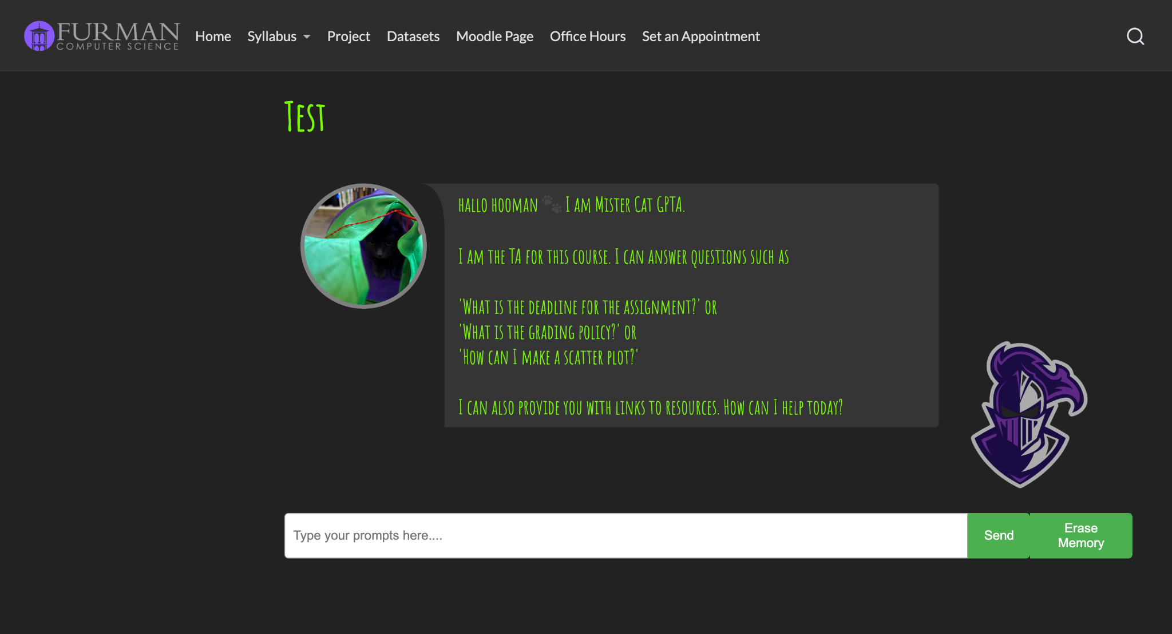
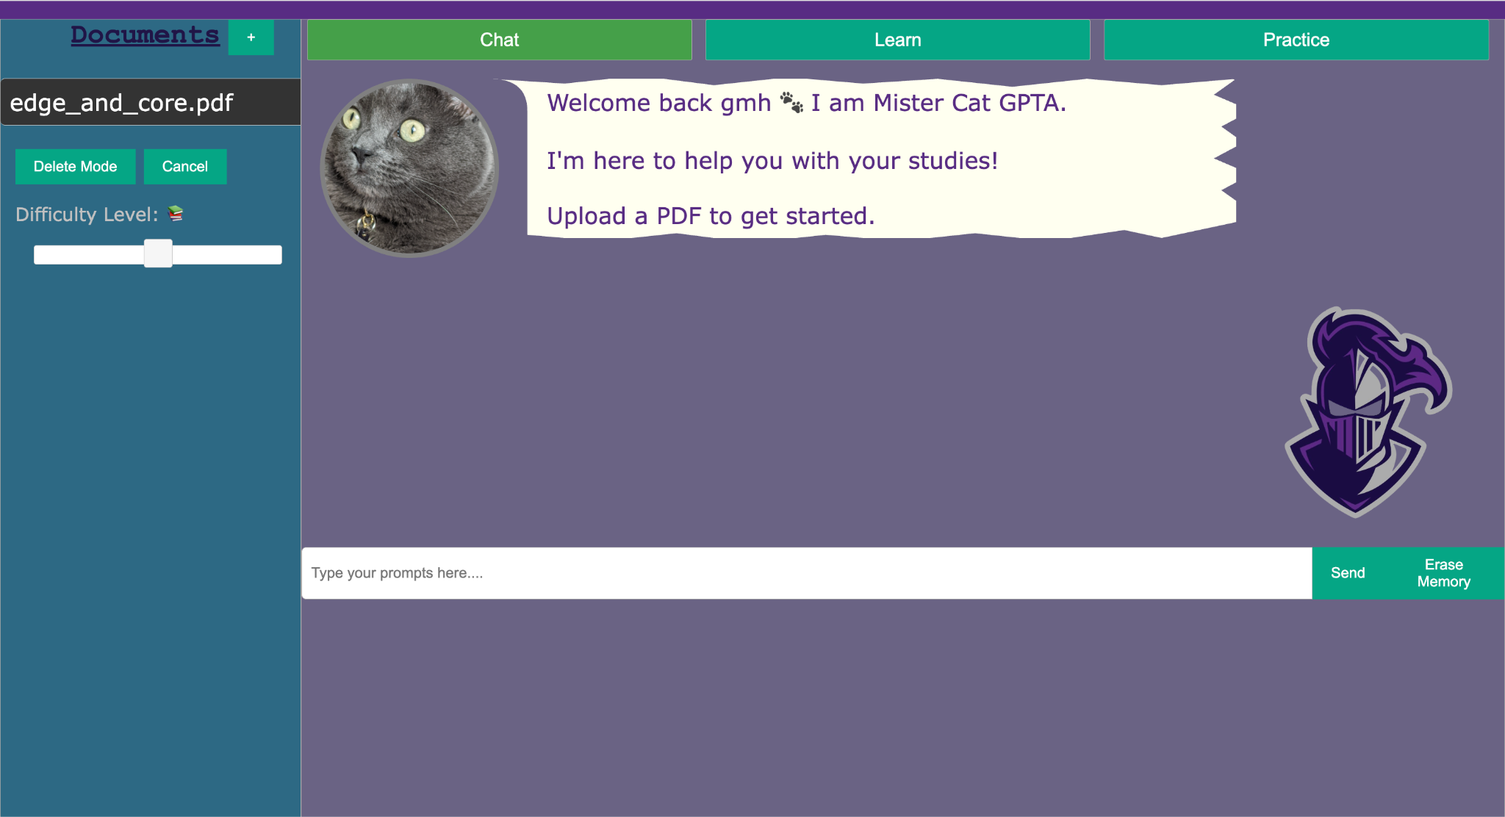
2024
2025
Specialized for CSC-272
Preset “knowledge”
Chat functionality only
Meant to supplement a TA
General purpose learning website
Chat, flashcards, test generation
Dynamic “knowledge”
Meant to create seamless study regimens

Slide 6
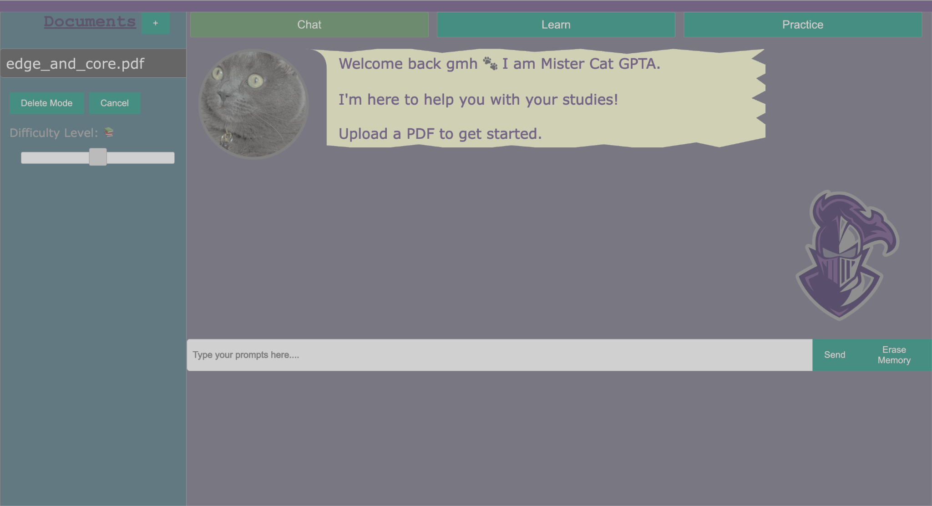
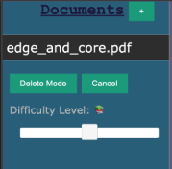

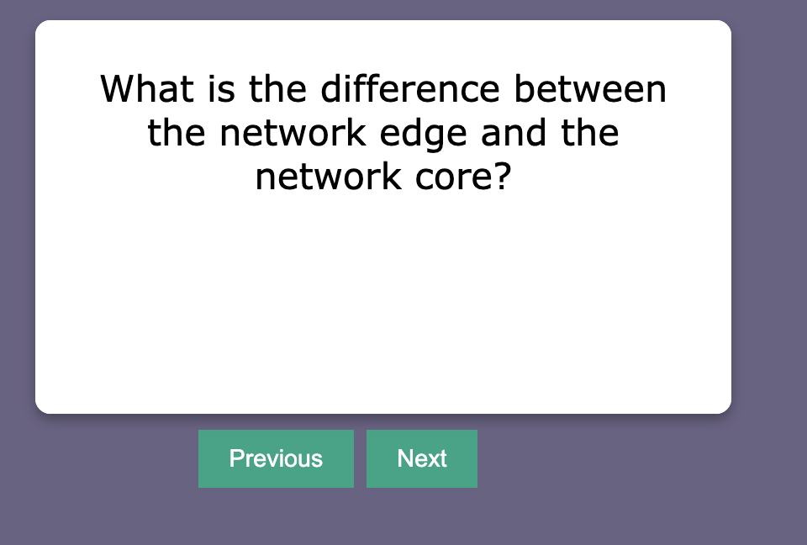
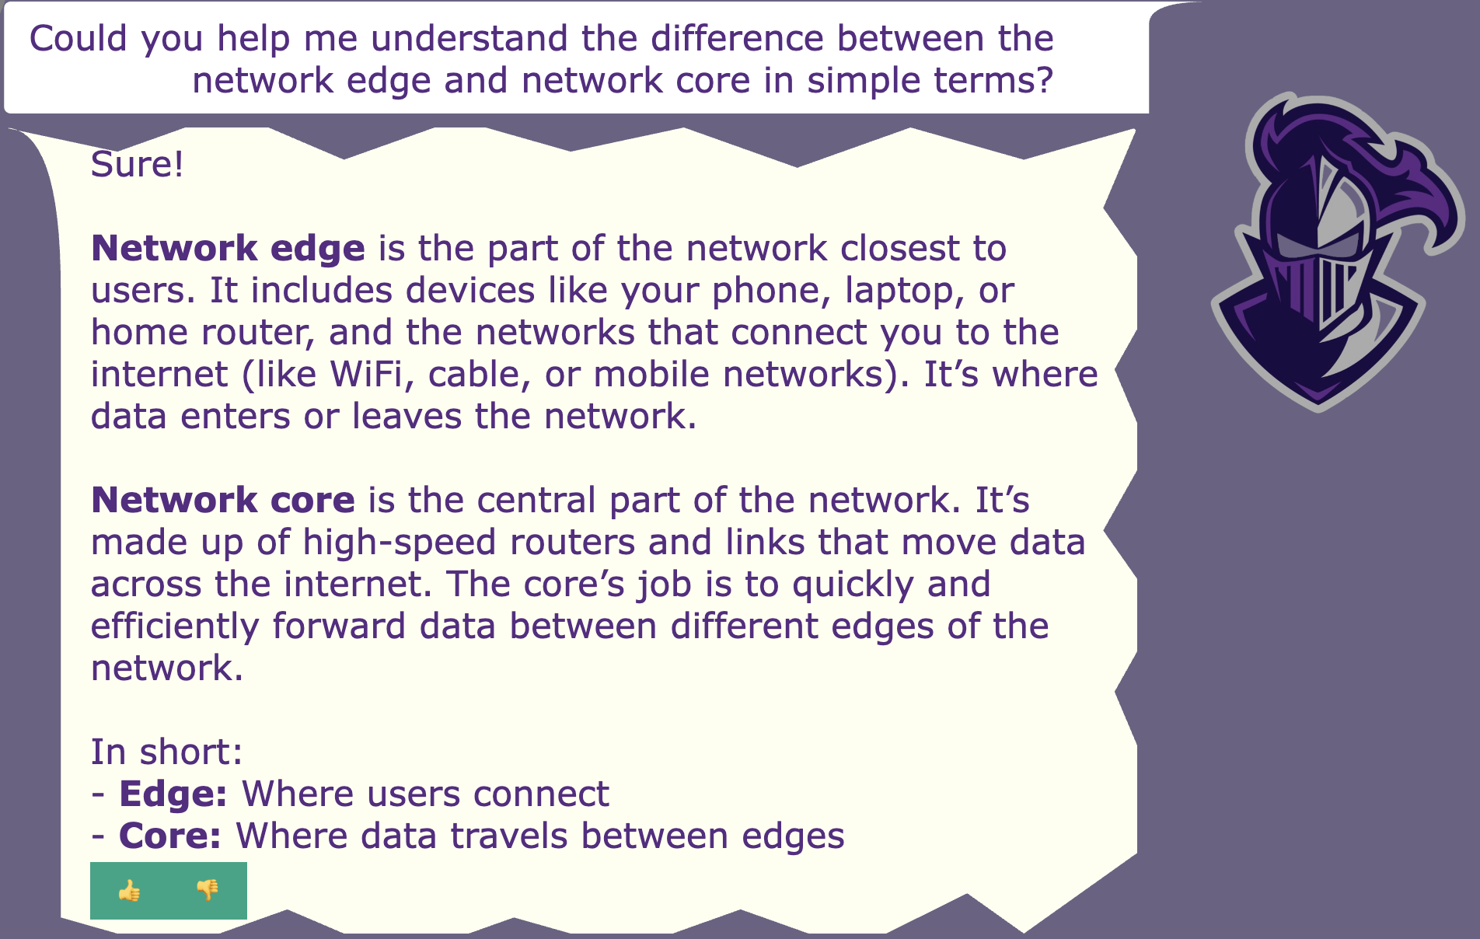
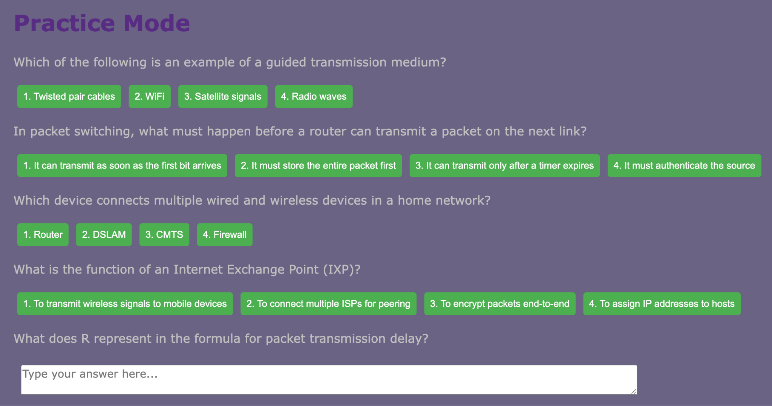
Upload Document
LLM
User
Chat Mode
Purpose: Open-ended, exploratory learning
Ask questions to a chatbot. You can flavor the chatbot’s knowledge pool with specific documents if you want.
Learn Mode
Purpose: Memorization, focus on particular points and concepts
Create flashcards based on the content of a document
Practice Mode
Purpose: Apply knowledge
Take a multimodal quiz based on document content. Difficulty settings determine breadth of questions*.

Slide 7
Demo

Slide 8
Challenges & Next Steps
(Open Questions)
Notes:
These are “open questions”

Slide 9

Challenge 1: Design
How can we ensure that users a) can quickly understand how it works, and b) know how to use it effectively?
 | UI | Focus Guardrails | Info Safety
Goal | Naturally point users towards useful features in the right order (also make it look decent) | Avoid mindless copy-pasting for answers | Ensure session data is, and stays, private
Solution |  | Instructions to avoid direct answers “Learn” and “Practice” modes demand engagement with material | Username-based authentication (WIP) 2FA? Consistency between different sessions from same user

Slide 10
Challenge 2: Relevance
Why would anyone use this as opposed to (insert popular chatbot) ?
Interface - Familiar, interactive learning methods
Low-effort setup - Users don’t need to specifically tailor certain types of questions
By Furman, for Furman - Open-source for the Furman community

Slide 11
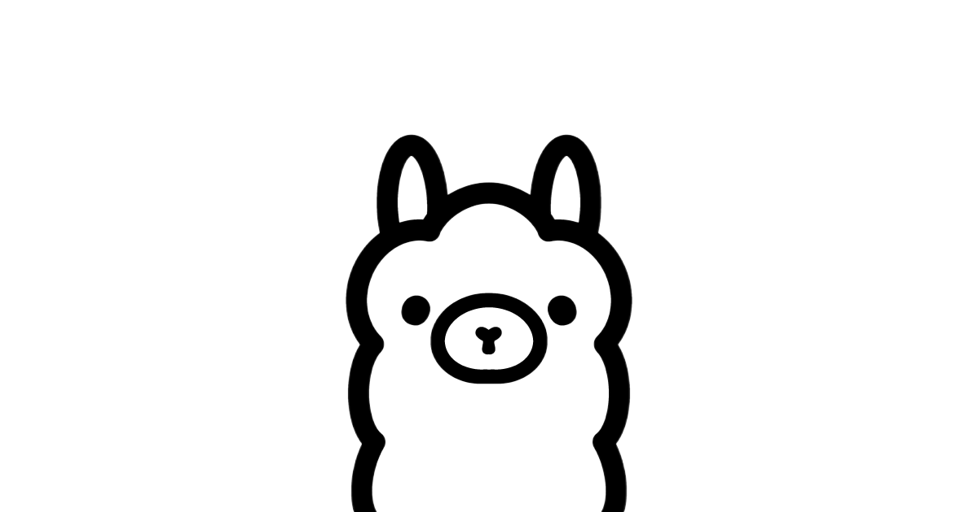
Challenge 3: Cost
LLM APIs are expensive - so why not use a local one?
Right now, Mr. Cat GPTA uses the OpenAI API to query the GPT-4.1 LLM. Each query costs us money. Why haven’t we pivoted to a “free” alternative?
Locally deployed open-source LLM (Ollama 2)
Used LangChain as an intermediary framework
Unfortunately open-source models* are still:
Orders of magnitude slower
Sub-par quality
Requires beefy infrastructure (compute, storage)
General maintenance cost
*at least, as we implemented them
Notes:
pennies but they add up quickly

Slide 12
Next Steps
Task | Priority
Graphical overhaul | High
Chat history security | High
Investigate local LLMs on more powerful machinery | Med
Reconsider token output limits | Low
Improve difficulty slider (better defined difficulties, new question types for higher diffs) | Low

Slide 13
Last Word on “For Students, By Students”
Code by Students, for Students: Collaborative Learning with Peer-Generated Resources
Other Code for Students, by Students projects:
Furman Now! --- Campus Community
Planadin --- Advising and Course Planning
Mr. Cat GPTA --- Academic preparation

Slide 14
Works Cited
Questions?
Labadze, L., Grigolia, M. & Machaidze, L. Role of AI chatbots in education: systematic literature review. Int J Educ Technol High Educ 20, 56 (2023). https://doi.org/10.1186/s41239-023-00426-1
Schäfer, A.M., Zimmermann, H.G. (2006). Recurrent Neural Networks Are Universal Approximators. In: Kollias, S.D., Stafylopatis, A., Duch, W., Oja, E. (eds) Artificial Neural Networks – ICANN 2006. ICANN 2006. Lecture Notes in Computer Science, vol 4131. Springer, Berlin, Heidelberg. https://doi.org/10.1007/11840817_66

